Slide 1
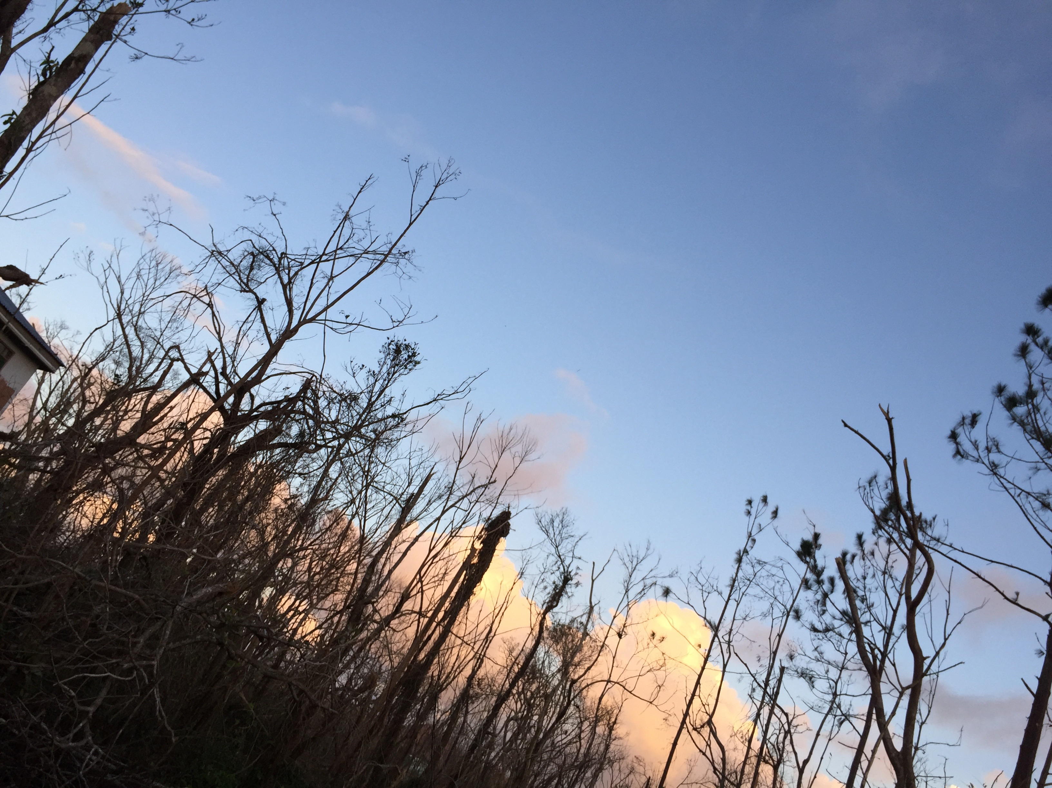

Mapping Trade and Supply Chains for Humanitarian and Business Resilience. Method and Preliminary Findings for Pilot Project and
Online Trade Data Service Design
Maribel Aponte García, Ph.D.
University of Puerto Rico, Río Piedras Campus
Carlos A. Álvarez, Industrial Engineering student, University of Puerto Rico, Mayaguez campus
Virtual Seminar, Resiliency and Business Innovation Program
Puerto Rico Science, Technology and Research Trust,
August 26, 2020.

Slide 2
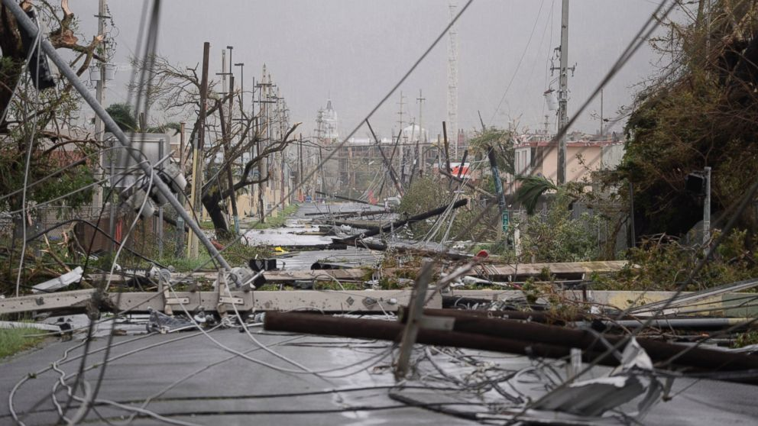
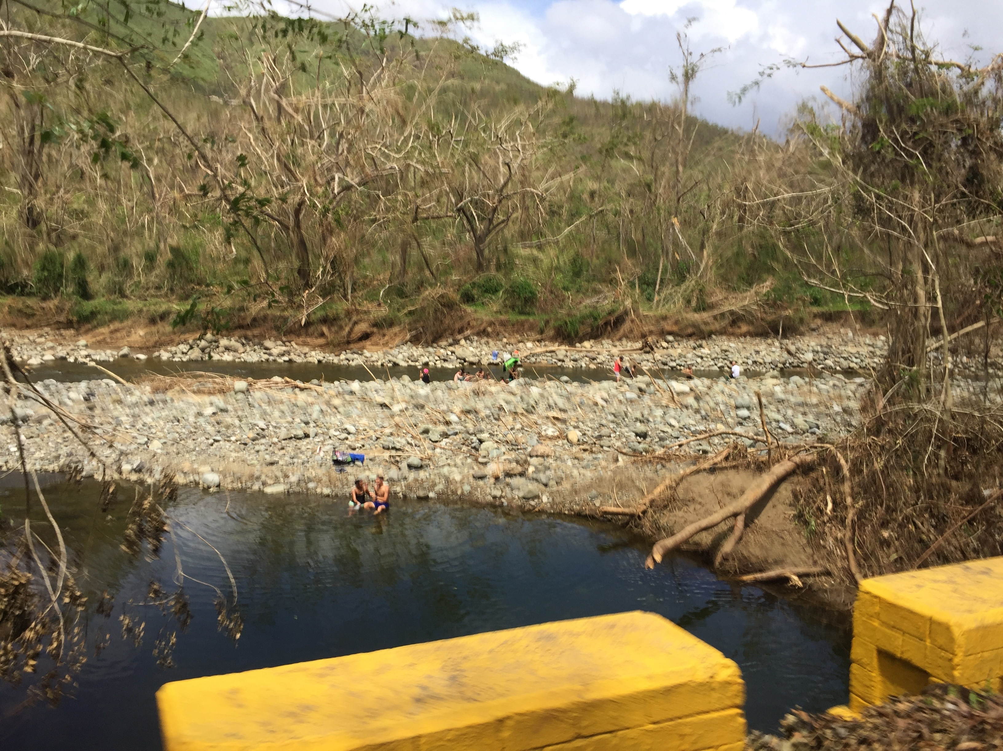
This research project was supported by the Resiliency and Business Innovation Program from Puerto Rico’s Science, Technology and Research Trust.

Slide 3
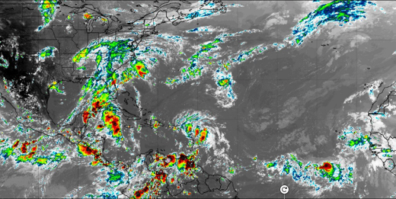
Hurricane Maria’s impact on Puerto Rico disrupted trade and supply chains of small and medium enterprises (SMEs), leaving approximately 80-90% of the 45,000 SMEs that sustain PR’s economy inoperative. Mapping trade and supply chains are also fundamental for humanitarian organizations and relief agencies tasked with getting and delivering critical goods fast.
What became evident was that for islands, resiliency capabilities’ building in trade and supply chains is crucial in disaster and emergency settings. Strengthening trade value chains will build resilience.

Slide 4
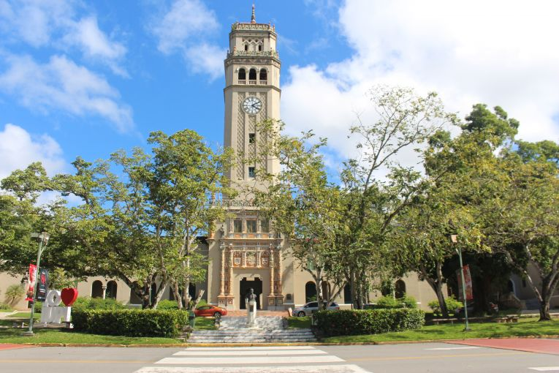
The Graduate School of Business Administration at the University of Puerto Rico, Rio Piedras Campus, has helped SMEs develop trade strategies since 2015:
The 2015–2017 UPRRP agreement with Puerto Rico Trade and Export’s Expo-Partners Program.
2015- Mapping Chains, Businesses and Supplier Networks in International Trade Project. Director and founder, Maribel Aponte García.

Slide 5
Project incorporated critical goods under the COVID-19 pandemic as atmospheric disasters might coincide with a pandemic scenario.

Slide 6
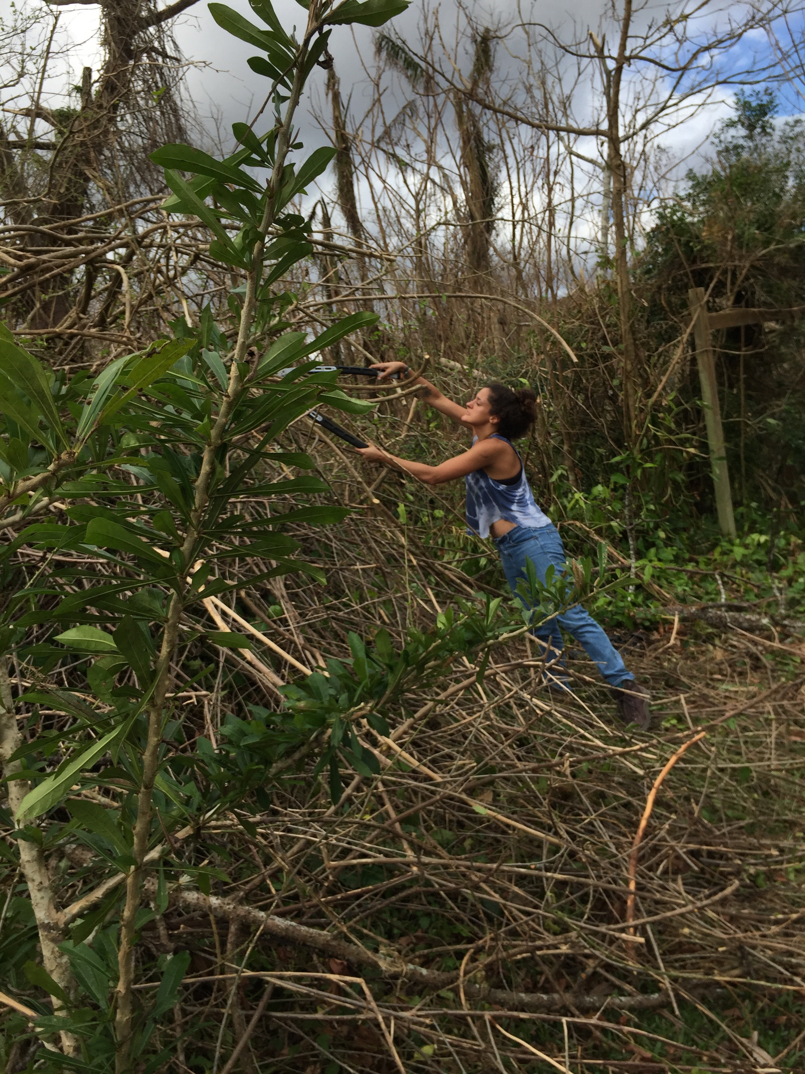
Project’s goals:
Develop method to identify alternatives to trade and supply chain disruptions for four critical imports, utilizing databases on trade, and identifying alternative sources of imports.
Evaluate some feasibility components of an Online Service for small and medium enterprises (SMEs) providing information on Trade and Supply Chains to help build resiliency.

Slide 7
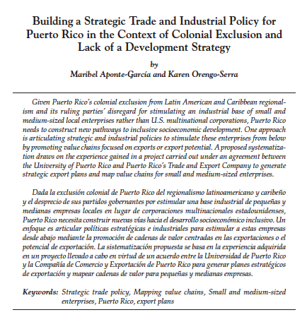
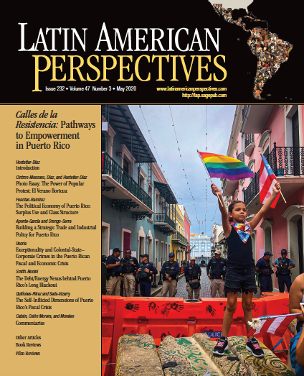

Recent publication on topic:

Slide 8
Method
Mixed methods were employed.
Concept required obtaining information from trade databases.
Analyze imports in order to identify alternative supplier networks.
Analyze exports as indicator of local supplier capacity.

Slide 9
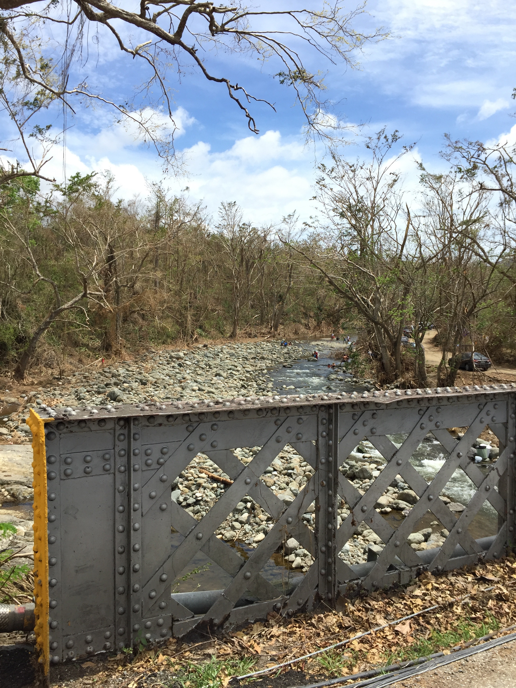
Method Addresses Knowledge and Methodological Gaps in Research
There is no method of analysis linking annual international trade data, supply chains, and companies.
Analyses of global disruptions in supply chains, is an under-researched topic.
No integrated database with company names exists for PR.
Scarce literature on natural disasters’ effects on businesses.
Few analyses on strategic options for Puerto Rico.

Slide 10
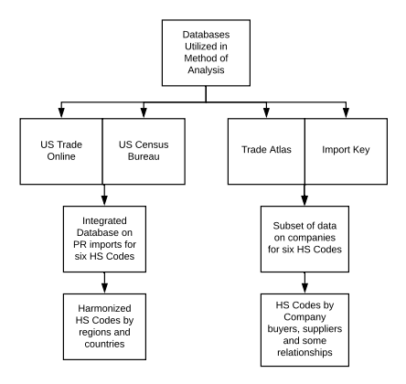
Steps applied in method included:
1. Selected products for analysis:
water
relief goods
solar products
diagnostic reagents
2. Analyzed data for products in different databases

Slide 11
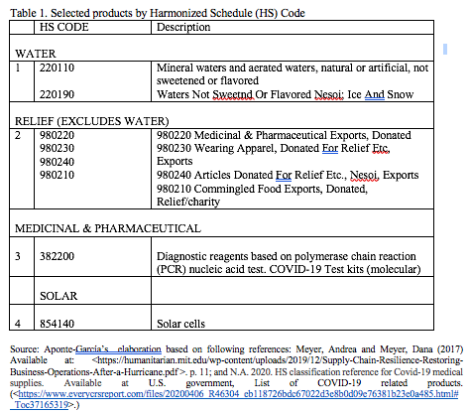
3. Evaluated HS codes’ data on Trade Atlas database. Prepared Excel files for critical goods and SMEs exports and created integrated data files.
4. Generated an integrated database for Puerto Rico’s imports from world for six HS codes

Slide 12
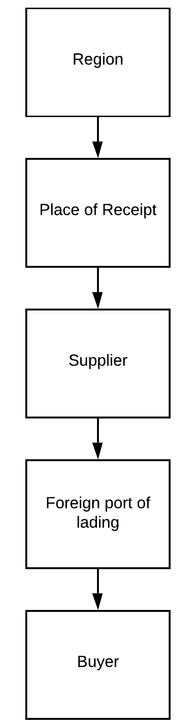
5. Evaluated HS codes’ data on Import Key database.
6. Identified alternative supplier network solutions to disruptions in trade value chains at several levels: region, foreign port of receipt, foreign port of lading, buyer and supplier.
7. Created tables and maps of import suppliers and export markets

Slide 13
Preliminary Findings

Slide 14
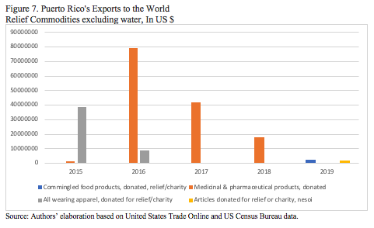
Relief Goods
Puerto Rico exported donations of medicinal and pharmaceutical products, in 2017 and 2018, in the crux of the post-hurricane devastation.

Slide 15
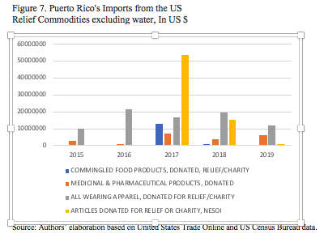
Supply Chains for Imports of Relief Goods
The Caribbean was both important as place of receipt and of lading during 2017.
Almost all buyers were humanitarian relief organizations and/or federal emergency disaster agencies.
Among the top five suppliers for 2017 is FEMA, which imported supplies from China and the Virgin Islands.
Source: Carlos A. Álvarez’s elaboration based on Import Key database.

Slide 16
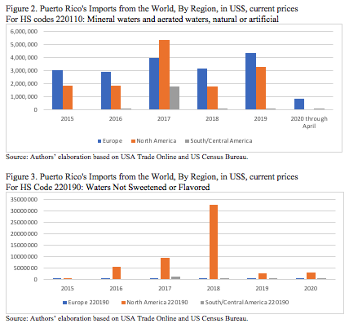
Water (3 categories) mineral, common and relief
Europe holds an important position in the market of HS Code 220110, that captures mineral waters which tend to be more expensive; while HS Code 220190, which is “common” water, a critical and essential good during disasters, and highly scarce in Puerto Rico in the aftermath of Hurricane Maria, is dominated by Puerto Rico’s imports from the U.S. and Canada.

Slide 17
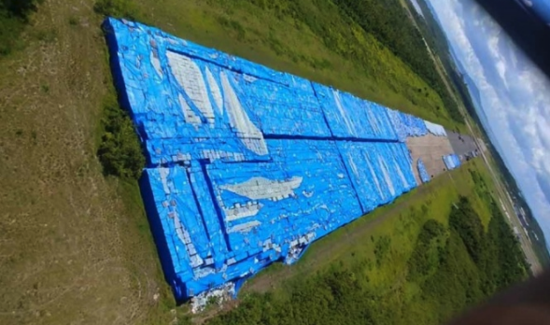
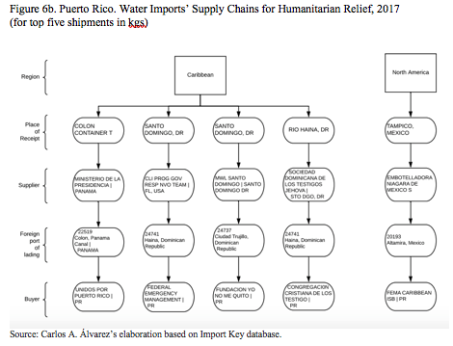
Supply Chains for Imports of RELIEF WATER
Humanitarian relief organizations imported from the Caribbean and Mexico. When disasters strike, rapid response depends on Caribbean ports. Ports of lading were all Caribbean, including Dominican Republic, Mexico, Trinidad and Tobago and Virgin Islands.
https://www.globalmedia.mx/articles/Indagan-miles-de-botellas-de-agua-abandonadas-eran-para-v%C3%ADctimas-de-Mar%C3%ADa-

Slide 18
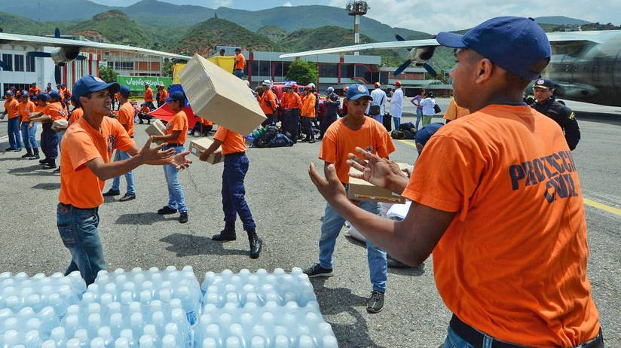
https://www.fromthegrapevine.com/nature/people-helping-puerto-rico-hurricane-maria

Slide 19

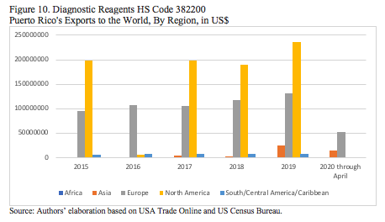
Diagnostic Reagents
“Pero a medida que el país se enfrenta a la pandemia de COVID-19, las compañías farmacéuticas, y las pruebas y los reactivos que producen, han tenido poca presencia en la crisis.”
http://hedgeclippers.org/pain-and-profit-covid-19-profiteers-in-puerto-rico/, p. 3.
Puerto Rico exports diagnostic reagents, and has been criticized for continuing to do so after the pandemic

Slide 20
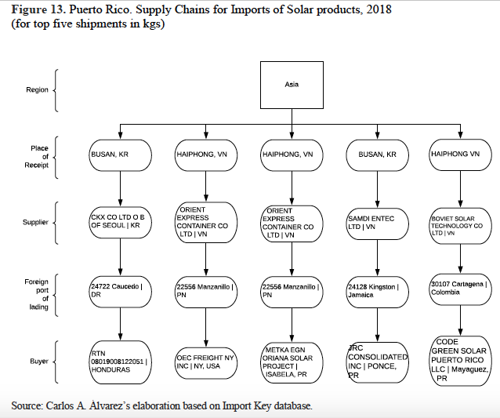
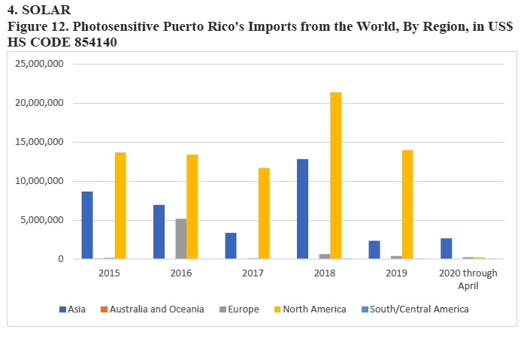
Figure 13 illustrates the dependency on Asian places of receipt for the subset of cases
available in the Import Key database.

Slide 21
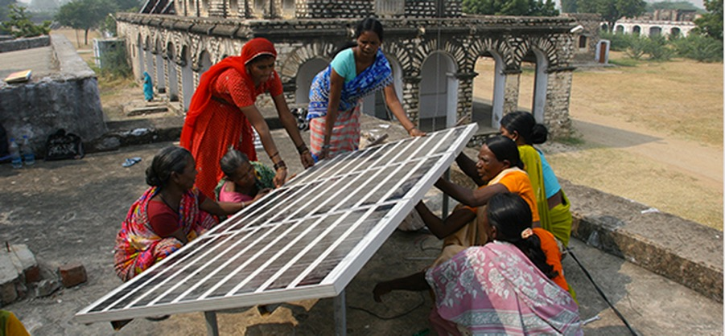
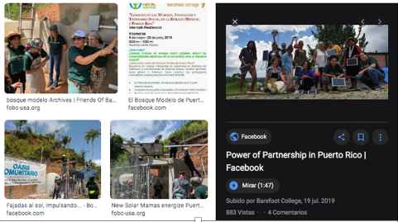
“Se brindó apoyo a la organización sin fines de lucro Barefoot College, para identificar a mujeres interesadas en un internado que se efectuó en 2018, sobre la construcción e instalación de placas solares en sus comunidades.”
Barefoot College-India
https://www.bosquemodelopr.org/wp-content/uploads/2018/04/Informe-de-Progreso-Anual-2018.pdf
http://www.barefootcollege.org/about/funding-collaboration/

Slide 22
Analysis of Feasibility Components for Online Service
Proposed online service was conceptualized as an alternative to provide much needed (and inexistent at present) trade data to provide alternatives for humanitarian and SMEs logistics. The idea was to evaluate some feasibility components of online service’s commercialization.

Slide 23
Conclusions
Pilot Project contributed preliminary findings that throw light into how to build resiliency. Analysis can be extended to groups of products according to validated lists of critical-essential goods classified by harmonized code.
Method has been improved by utilizing several resources to generate an integrated trade database for Puerto Rico and supply chains’ maps/diagrams.
Online Service must also consider other alternatives other than the UPRRP.
The Caribbean constitutes an alternative supply chain network, along with Mexico, that have proved crucial under disasters, not only for companies but also for humanitarian relief organizations. The United States has also played an important role, utilizing Caribbean and Central American ports of receipt and of lading, as an alternative supplier network.
Harmonized Codes for relief (9802) are important to understand responses to disasters.
Puerto Rico’s role as an exporter of medicinal and pharmaceutical donations, is a paradoxical fact in the context of atmospheric and pandemic disasters.

Slide 24
¡Muchas gracias!
Maribel Aponte García
maribel.aponte1@upr.edu
maribelapontegarcia@gmail.com
https://urrp.academia.edu
Carlos A. Álvarez carlos.alvarez9@upr.edu

